Slide 1
Help Wanted Online A real-time measure of job postings
November 2021
Office of Research Connecticut Department of Labor
Connecticut Department of Labor – Research Office 200 Folly Brook Blvd. Wethersfield, CT 06109
Help Wanted Online

Slide 2
What is HWOL?
The Conference Board Help Wanted Online® Data Series (HWOL) measures the number of new, first-time Online job postings and jobs reposted from the previous month for over 50,000 Internet job boards, corporate boards and smaller job sites that serve niche markets and smaller geographic areas.
Connecticut Department of Labor – Research Office 200 Folly Brook Blvd. Wethersfield, CT 06109
Help Wanted Online

Slide 3
Upcoming Release Dates
Monthly Report: Friday, December 10th, 2021 Weekly New Ads Report: Updated every Friday
Connecticut Department of Labor – Research Office 200 Folly Brook Blvd. Wethersfield, CT 06109
Help Wanted Online

Slide 4
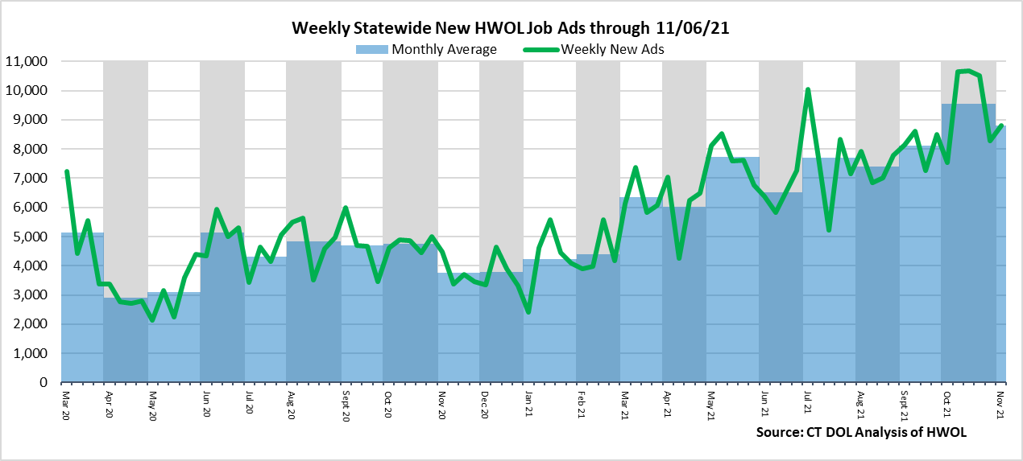
Statewide Weekly New Job Ads
Weekly New job postings were 8,804 during the week ending 10/16/21.
Connecticut Department of Labor – Research Office 200 Folly Brook Blvd. Wethersfield, CT 06109
Help Wanted Online

Slide 5
HWOL New Weekly Industry Job Ads – CT Statewide
Connecticut Department of Labor – Research Office 200 Folly Brook Blvd. Wethersfield, CT 06109
Help Wanted Online

Slide 6
Connecticut Department of Labor – Research Office 200 Folly Brook Blvd. Wethersfield, CT 06109
Help Wanted Online

Slide 7
Employers with the Most New Job Postings
Connecticut Department of Labor – Research Office 200 Folly Brook Blvd. Wethersfield, CT 06109
Help Wanted Online

Slide 8
Monthly HWOL Information
The following pages contain HWOL monthly data for October 2021. Monthly and weekly job ad information can be found here: https://www1.ctdol.state.ct.us/lmi/HWOL.asp
Connecticut Department of Labor – Research Office 200 Folly Brook Blvd. Wethersfield, CT 06109
Help Wanted Online

Slide 9
Statewide Highlights
- Total postings in Connecticut was 104,973 in October 2021. -Industry sectors with the most job postings were Health Care and Social Assistance (20,754 postings), Retail Trade (16,320 postings), Finance and Insurance (7,958 posting), and Professional, Scientific, and Technical Services (7,001 postings).
-Occupations with the most postings were Registered Nurses (5,572 postings), Laborers & Freight, Stock, and Material Movers (4,152 postings), Retail Salespersons (3,470 postings), Wholesale and Manufacturing Sales Representatives (2,394 postings), and Heavy & Tractor-Trailer Truck Drivers (2,173 postings).
Connecticut Department of Labor – Research Office 200 Folly Brook Blvd. Wethersfield, CT 06109
Help Wanted Online

Slide 10
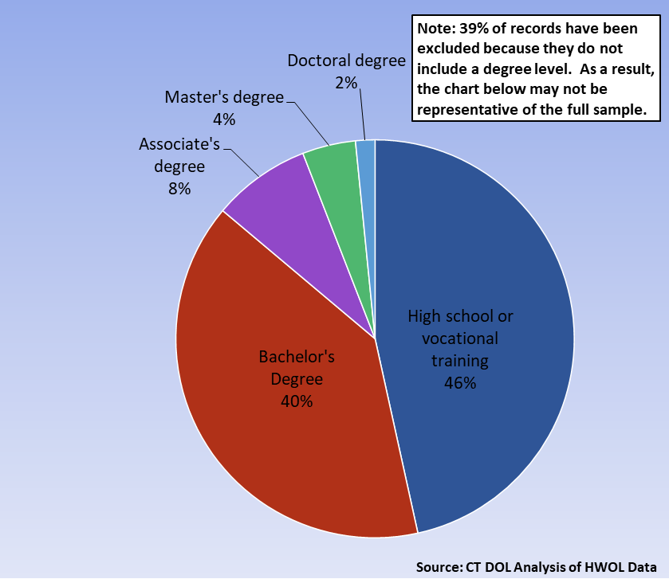
Connecticut Job Ads by Educational Requirements
Connecticut Department of Labor – Research Office 200 Folly Brook Blvd. Wethersfield, CT 06109
Help Wanted Online

Slide 11
Top Certifications in Connecticut Job Ads
Connecticut Department of Labor – Research Office 200 Folly Brook Blvd. Wethersfield, CT 06109
Help Wanted Online

Slide 12
Top Skills in Connecticut Job Ads
Connecticut Department of Labor – Research Office 200 Folly Brook Blvd. Wethersfield, CT 06109
Help Wanted Online

Slide 13
Top Skills by Industry in Connecticut Job Ads
Connecticut Department of Labor – Research Office 200 Folly Brook Blvd. Wethersfield, CT 06109
Help Wanted Online

Slide 14
Top Skills by Industry in Connecticut Job Ads (Continued)
Connecticut Department of Labor – Research Office 200 Folly Brook Blvd. Wethersfield, CT 06109
Help Wanted Online

Slide 15
Connecticut Department of Labor – Research Office 200 Folly Brook Blvd. Wethersfield, CT 06109
Help Wanted Online

Slide 16
Connecticut Employers with the Most Job Ads
Connecticut Department of Labor – Research Office 200 Folly Brook Blvd. Wethersfield, CT 06109
Help Wanted Online

Slide 17
Connecticut Occupations with the Most Job Ads
Connecticut Department of Labor – Research Office 200 Folly Brook Blvd. Wethersfield, CT 06109
Help Wanted Online

Slide 18
Connecticut Job Ads by Industry and Major Occupational Group
Connecticut Department of Labor – Research Office 200 Folly Brook Blvd. Wethersfield, CT 06109
Help Wanted Online

Slide 19
Workforce Area Data
Workforce Area Highlights
Job Ads by Industry
Job Ads by Location
Employers With The Most Job Ads
Occupations With The Most Job Ads
Connecticut Department of Labor – Research Office 200 Folly Brook Blvd. Wethersfield, CT 06109
Help Wanted Online

Slide 20
Workforce Area Highlights
Connecticut Department of Labor – Research Office 200 Folly Brook Blvd. Wethersfield, CT 06109
Help Wanted Online

Slide 21
Connecticut Department of Labor – Research Office 200 Folly Brook Blvd. Wethersfield, CT 06109
Help Wanted Online

Slide 22
Eastern Workforce Job Ads by Location
Connecticut Department of Labor – Research Office 200 Folly Brook Blvd. Wethersfield, CT 06109
Help Wanted Online

Slide 23
Eastern Workforce Employers
with the Most Job Ads
University of Connecticut
Mohegan Sun
Day Kimball Healthcare
Lowe's Companies, Inc
Compass Group North America
Groton Public Schools
Advantage Sales & Marketing
Walgreens Boots Alliance Inc
Natchaug Hospital Incorporated
Hyatt
Asplundh Tree Expert Company
Reliance Health Group
United Parcel Service Incorporated
US Foods
Thames Valley Council For Community Action
McDonald's
The Home Depot Incorporated
Nordson Corporation
Yale-New Haven Health System
Amazon
Pfizer
General Dynamics
Fm Global
State of Connecticut
Norwich Public Schools
Walmart / Sam's
Petco
United Services Incorporated
Staples
Masonicare Corporation
Sonalysts Incorporated
Generations Family Health Center
Bob's Discount Furniture
FedEx
Windham Public Schools
Hartford Healthcare Medical Group Specialists
United Community Family Services Incorporated
Connecticut Department of Labor – Research Office 200 Folly Brook Blvd. Wethersfield, CT 06109
Help Wanted Online

Slide 24
Eastern Workforce Occupations
with the Most Job Ads
Connecticut Department of Labor – Research Office 200 Folly Brook Blvd. Wethersfield, CT 06109
Help Wanted Online

Slide 25
Connecticut Department of Labor – Research Office 200 Folly Brook Blvd. Wethersfield, CT 06109
Help Wanted Online
25

Slide 26
North Central WDA Job Ads by Location
Connecticut Department of Labor – Research Office 200 Folly Brook Blvd. Wethersfield, CT 06109
Help Wanted Online

Slide 27
North Central WDA Employers
with the Most Job Ads
Raytheon
Hartford Healthcare
Cigna Corporation
Trinity Health
State of Connecticut
Travelers
Accenture
CVS Health
Connecticut Children's Medical Center
ICF
Aya Healthcare
United Parcel Service Incorporated
Wheeler Clinic
FedEx
Disney
Beech Valley Solutions
Boston Market
Laboratory Corporation of America
Ryder System Incorporated
Amazon
UnitedHealth Group
Deloitte
Salesforce
ECHN
The Hartford Financial Group
Allied Universal
Advantage Sales & Marketing
Pratt & Whitney
Change Healthcare
Stanley Black & Decker
Nelnet
The Home Depot Incorporated
Guidehouse
Whole Foods Market, Inc.
Sysco Corporation
Travelers Hartford
Walgreens Boots Alliance Inc
Black & Veatch
Connecticut Department of Labor – Research Office 200 Folly Brook Blvd. Wethersfield, CT 06109
Help Wanted Online

Slide 28
North Central WDA Occupations
with the Most Job Ads
Connecticut Department of Labor – Research Office 200 Folly Brook Blvd. Wethersfield, CT 06109
Help Wanted Online

Slide 29
Connecticut Department of Labor – Research Office 200 Folly Brook Blvd. Wethersfield, CT 06109
Help Wanted Online

Slide 30
Northwest WDA Job Ads by Location
Connecticut Department of Labor – Research Office 200 Folly Brook Blvd. Wethersfield, CT 06109
Help Wanted Online

Slide 31
Northwest WDA Employers
with the Most Job Ads
Amazon
Nuvance Health
Hartford Healthcare
Waterbury Hospital
Advantage Sales & Marketing
The Home Depot Incorporated
UnitedHealth Group
Naugatuck Public Schools
Trinity Health Of New England
Beech Valley Solutions
Benchmark Senior Living
Stop Shop Supermarket
Monterey Institute Of International Studies
YRC Freight
CVS Health
BJ's Wholesale Club, Inc.
Mercy Medical Center Clinton
Macy's
Boehringer Ingelheim
Aya Healthcare
Trinity Health
United Parcel Service Incorporated
State of Connecticut
Whole Foods Market, Inc.
Petco
Compass Group North America
Walgreens Boots Alliance Inc
Charlotte Hungerford Hospital
Seasons Hospice & Palliative Care
State Farm Insurance Companies
Trugreen
Post University
Club Demonstration Services
YMCA
Walmart / Sam's
Realogy Franchise Group LLC
Edadvance
Connecticut Department of Labor – Research Office 200 Folly Brook Blvd. Wethersfield, CT 06109
Help Wanted Online

Slide 32
Northwest WDA Occupations
with the Most Job Ads
Connecticut Department of Labor – Research Office 200 Folly Brook Blvd. Wethersfield, CT 06109
Help Wanted Online

Slide 33
Connecticut Department of Labor – Research Office 200 Folly Brook Blvd. Wethersfield, CT 06109
Help Wanted Online

Slide 34
South Central WDA Job Ads by Location
Connecticut Department of Labor – Research Office 200 Folly Brook Blvd. Wethersfield, CT 06109
Help Wanted Online

Slide 35
South Central WDA Employers
with the Most Job Ads
Amazon
Yale-New Haven Health System
Anthem Blue Cross
Hartford Healthcare
Advantage Sales & Marketing
United Parcel Service Incorporated
Middlesex Health System Incorporated
UnitedHealth Group
Lowe's Companies, Inc
Allied Universal
Raytheon
Department of Veterans Affairs
Genesis Healthcare Corporation
Beech Valley Solutions
Honeywell
Midstate Medical Center
Michaels Arts and Crafts
Seasons Hospice & Palliative Care
Boston Market
Yale University
Medtronic
Community Health Center, Inc.
Masonicare Corporation
State of Connecticut
Petco
The Home Depot Incorporated
Gaylord Specialty Healthcare
Aya Healthcare
FedEx
Walgreens Boots Alliance Inc
Quest Diagnostics Incorporated
Avangrid
Wesleyan University
Walmart / Sam's
Benchmark Senior Living
Quinnipiac University
Subway Ip, Llc
Actalent
Connecticut Department of Labor – Research Office 200 Folly Brook Blvd. Wethersfield, CT 06109
Help Wanted Online

Slide 36
South Central WDA Occupations
with the Most Job Ads
Connecticut Department of Labor – Research Office 200 Folly Brook Blvd. Wethersfield, CT 06109
Help Wanted Online

Slide 37
Connecticut Department of Labor – Research Office 200 Folly Brook Blvd. Wethersfield, CT 06109
Help Wanted Online

Slide 38
Southwest WDA Job Ads by Location
Connecticut Department of Labor – Research Office 200 Folly Brook Blvd. Wethersfield, CT 06109
Help Wanted Online

Slide 39
Southwest WDA Employers
with the Most Job Ads
Deloitte
Humana
Stamford Hospital
Aya Healthcare
Norwalk Public School District
Allied Universal
Compass Group North America
KPMG
Sema4
Synchrony
United Parcel Service Incorporated
The Home Depot Incorporated
Sacred Heart University
Circle Internet Financial Limited
Nuvance Health
World Wrestling Entertainment
Hartford Hospital
NBC
Petco
Amazon
Vmware Incorporated
Yale-New Haven Health System
Charter Communications
ASML United States Incorporated
Whole Foods Market, Inc.
Hartford Healthcare
Advantage Sales & Marketing
Gartner Incorporated
Lockheed Martin Corporation
Capital One
Norwalk Public Schools
Rolls Royce Plc
Griffin Health
UnitedHealth Group
Nordstrom
Beech Valley Solutions
Watermark Retirement Communities
Connecticut Department of Labor – Research Office 200 Folly Brook Blvd. Wethersfield, CT 06109
Help Wanted Online

Slide 40
Southwest WDA Occupations
with the Most Job Ads
Connecticut Department of Labor – Research Office 200 Folly Brook Blvd. Wethersfield, CT 06109
Help Wanted Online

Slide 41
All advertisement data used in this publication is from the Conference Board’s Help Wanted Online data series.
For more information or data requests, contact Matthew Krzyzek in the Office of Research at the Department of Labor.
Matthew.Krzyzek@ct.gov
For more Connecticut Labor Market Information visit:
www.ctdol.state.ct.us/lmi
https://www.facebook.com/ctlmi
Twitter: @DOL_Research
Connecticut Department of Labor – Research Office 200 Folly Brook Blvd. Wethersfield, CT 06109
Help Wanted Online

